Slide 1
Introduction to Peer Support
Module 1
Notes:
Trainer Manual
Module 01: Peer Support © 2023 PeerWorks
This training program is designed to be accessible to all trainers, and ensure that all participants receive the same quality of education regardless of specific trainers’ background and experience.
This manual is a living document and should be understood as a set of guidelines, not as a fixed script. Feel free to adapt the language to your style of presentation. We also recognize that language is always changing; please update terminology when necessary. The synchronous sessions should be dynamic, engaging experiences.
COORDINATOR
“Hello everyone and welcome to the first module of PeerWorks' Peer Support Core Essentials Program. Module 1 is ‘Introduction to Peer Support.’ This module will serve as an introduction to our training program, as well as an introduction to the field of Peer Support.”

Slide 2
Land Acknowledgement
Module 1 – Introduction to Peer Support
I am speaking to you today from Toronto. Toronto is in the 'Dish With One Spoon Territory’. The Dish With One Spoon is a treaty between the Anishinaabe, Mississaugas and Haudenosaunee that bound them to share the territory and protect the land. Subsequent Indigenous Nations and peoples, Europeans and all newcomers have been invited into this treaty in the spirit of peace, friendship and respect.
The "Dish", or sometimes it is called the "Bowl", represents what is now southern Ontario, from the Great Lakes to Quebec and from Lake Simcoe into the United States. *We all eat out of the Dish, all of us that share this territory, with only one spoon. That means we have to share the responsibility of ensuring the dish is never empty, which includes taking care of the land and the creatures we share it with. Importantly, no knives are at the table, representing that we must keep the peace.
We want to acknowledge and respect all Indigenous people who don’t live in their traditional territories but have made a home in different parts of Ontario and have brought their culture with them.
Notes:
COORDINATOR
“The first thing we want to do today is read a Land Acknowledgement.”
Read PeerWorks’ land acknowledgement.
“As an Ontario-based mental health and addictions organization, it’s important for us to acknowledge the ongoing history of settler-colonialism in Canada and its impact on the indigenous inhabitants of this land. Indigenous communities in Canada have higher rates of mental health challenges and addictions, but far fewer healthcare resources. In Module 3, we will learn more about this with our discussion of Social Determinants of Health.
While we are all virtually together today, we are joining from different place across Ontario. As such, we invite you to learn more about your community’s relationship to the land and consider how this informs your practice. Our work as Peer Supporters is stronger and more relevant when it is culturally competent, and inclusive of all our community members.
We have included links in our resources where you can learn more about the land that you are on. If you are interested in opening one of our synchronous sessions with your own land acknowledgment that reflects where you are coming from, please let us know.”

Slide 3
Land Acknowledgement
Module 1 – Introduction to Peer Support
If any of you want to share a land acknowledgement for the area where you reside in any of our upcoming sessions, please let us know!
Notes:
TRAINER
“Next we’d like to launch a poll to gauge your familiarity with Peer Support.”
(COORDINATOR) Launch Zoom Poll asking:
How familiar are you with Peer Support?
Options:
Completely new to Peer Support
Have heard of Peer Support, but not experienced it
Have participated in some Peer Support
Have lots of experience with Peer Support
After everyone has voted, please read out the poll results.

Slide 4
Notes:
TRAINER
“Next thing we’d like to do today is get to know everyone.”
At this point, as the trainer, introduce yourself and what you would like to share about your experience with Peer Support. The slide will show a picture of you, along with some facts that you want to share with the participants.
Note: this slide will be updated with the trainer’s photo and bio.

Slide 5

Icebreaker Activity
Module 1 – Introduction to Peer Support
What is your name?
What is your experience with Peer Support?
What is your favourite fictional friendship?
Notes:
TRAINER
“Now for our first icebreaker. Every synchronous session will begin with a question. This aims to get us all comfortable talking and get to know each other better. We need to practice listening and sharing to develop the skills necessary for Peer Support.
Today’s icebreaker questions are: what is your name? What is your experience with Peer Support? And what is your favourite fictional friendship?”
As the trainers, feel free to go first. Keep it brief, but include an explanation for your choice of friendship. Thank people for sharing.

Slide 6

Housekeeping
Module 1 – Introduction to Peer Support
Please mute yourself if you are not speaking.
Feel free to include your pronouns in your Zoom Name.
Use Zoom reaction tools, chat box, hands up, etc.
Be prepared to have video on at all times; as such, please be appropriately dressed and limit distractions.
Contribute to the conversations out loud and in the chat box.
If someone has already shared what you were going to say, lower your hand and put “agree” in the chat.
Notes:
COORDINATOR
“The next slide is another one we will see at the beginning of each synchronous session. It contains the ‘Housekeeping’ related to Zoom sessions. These guidelines are intended to make the online environment run more smoothly. If you think anything is missing from these guidelines, please let us know. If you are having trouble accessing Zoom functions, contact us, and we will help you. We want to ensure that all the elements of these meetings are accessible to everyone.”
“Does anyone know why we suggest you put your pronouns in your Zoom Name?”
Answer: “Using your pronouns signals you will not assume anyone’s gender. It tells people how to refer to you and signals that others can feel comfortable sharing their pronouns.”

Slide 7
Expectations
Module 1-Introduction to Peer Support
Arrive on time.
Help us create a confidential and non-judgement space. The expectation is to be in a private setting with the camera on to create a safe space and maintain confidentiality. If you cannot have your camera on, please notify the Training Coordinator. (*This cannot be a recurring situation with the camera off.)
Please void substance use (i.e., smoking/vaping) while on camera, as these can be triggering for others. If you need to do so, please turn your camera off or wait for the break.
Please keep your phones on silent.
Avoid cross-talk and side-talk.
Learn from each person's perspective.
Language – please bring new language to us; we recognize that language is ever-changing.
Have fun!
Notes:
COORDINATOR
Read out Expectations slide.
“The first part of the homework was to reflect on our expectations and bring forward anything that you would like to add or alter. Now that we’ve had this time to reflect, what do you think could be added to our Expectations?”

Slide 8
Attendance Policy
Module 1 – Introduction to Peer Support
Attendance at all 17 live online classes is required for successful completion of this training. While some material can be made up, not all content is recoverable, and missing classes may affect your results.
We understand that unexpected situations may arise, and some absences may be beyond your control. However, Module 6: Cultural Competency, Module 8: Listening, and Module 9: Sharing are mandatory.
These sessions focus on skills that are foundational to the practice of peer support, and missing any of them will make participants ineligible to receive a Level 1R.
In addition, participants may not miss more than two (2) classes in total.
If you are unable to attend a class, please email your training coordinator

Slide 9
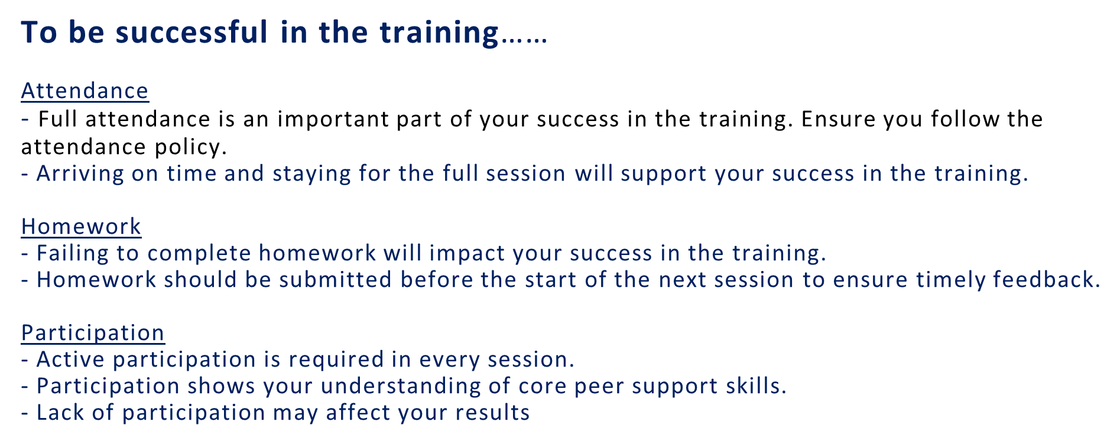
Module 1-Introduction to Peer Support

Slide 10
Module Overview & Learning Objectives
Module 1 – Introduction to Peer Support
In Module 1, we will consider the meaning of ‘Peer Support.’ Everyone will have the opportunity to share their thoughts about Peer Support and learn about differing points of view. We will compare our definitions of Peer Support and share our experiences receiving and offering Peer Support.
Through the successful completion of Module 1, you will be able to:
Define Peer Support.
Articulate the benefits of receiving and offering Peer Support.
Notes:
TRAINER
Read the Module Overview and the Learning Objectives out loud.

Slide 11
PeerWorks’ Mission & Vision
Module 1 – Introduction to Peer Support
PeerWorks represents the consumer voice by highlighting the achievements and challenges, potential and needs of our member organizations and the many individuals who use them.
We represent their interests at the major provincial mental health/addiction policy planning and strategy implementation tables.
Mission
PeerWorks’ mission is to strengthen and promote diverse peer voices in Ontario, through community building, information-sharing, collaboration, advocacy, and education.
Vision
A world in which lived experience is valued, peer autonomy and peer culture are protected, diversity is respected, and peer support is available to all.
Notes:
COORDINATOR
“Now that we have all gotten to know each other a little bit better, let’s introduce PeerWorks. While we have existed under several different names, PeerWorks has been around since 1991.”
Read the description of PeerWorks, as well as our Mission statement and vision.
“What questions do you have about PeerWorks and our role in the Peer Support field?”

Slide 12
Pre-module Homework
Module 1 – Introduction to Peer Support
Notes:
TRAINER
“The homework for this session was to watch a video and prepare a definition for Peer Support. Can everyone please have their definition available, as it will be required for our first group activity.
First, we want to open the room to questions or comments about the homework. What was your experience watching the video? Have you seen it before? What stood out about it?”

Slide 13
Breakout Rooms Activity
Module 1 – Introduction to Peer Support
Break into smaller groups and share your definitions of peer support. Discuss how they were similar and how they were different.
After sharing your definitions, list five words that came up most often or at least more than once. Have a recorder write these five words down and bring them back to the group.
(This activity should take approximately 10 to 15 minutes.)
Notes:
TRAINER
“We are going to go into breakout rooms now in small groups in order to share our definitions. In your groups, discuss how your definitions are similar and how they are different.
The purpose of the activity is to identify our existing knowledge about peer support and any assumptions we might have. At the end of the 17 modules, we can look back at our definitions and see how our understanding of Peer Support has changed.
After sharing your definitions, list five words that came up most often or at least more than once. Have a recorder write these five words down and bring them back to the group.”
Give the groups 10-15 minutes to go through their definitions and come up with their five words.
COORDINATOR: Bring up the whiteboard feature and have everyone add their words to it. This will visually represent some of the repeating words and allow the entire group to compare the most significant elements of their Peer Support definitions.
The half-way point of the training session will be roughly in the middle of the small group activity.

Slide 14
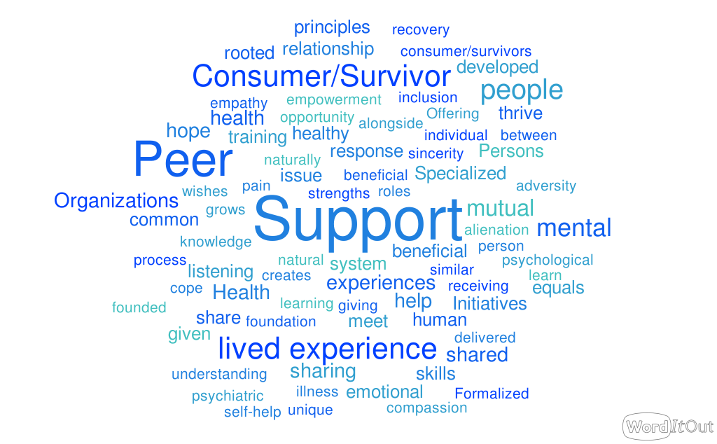
Notes:
TRAINER
“This is a word cloud generated from definitions of Peer Support by experienced Peer Supporters and Peers. The word cloud was created by analyzing definitions of Peer Support and identifying which words were repeated. The more often a word was repeated, the bigger it is in the word cloud.”
“Does this word cloud reflect our whiteboard? Do any words stand out? Do you think any words are missing?”
“One of the things I’ve noticed is how focused the language is on people and relationships, such as: people, persons, human, empathy, meet, sharing, similar, equals, etc. On the other hand, specific language about mental illness and addiction is not as present. This really emphasizes the person-centred approach of peer support, as opposed to a biomedical approach.
Another thing we’ve noticed is the words ‘training’ and ‘formalized.’ Our focus in this series of modules is on formalized Peer Support. Peer Supporters are trained professionals, who are providing a healthcare service.
This is different than friendship, though friendship is also a great system of support and strength.”

Slide 15
PeerWorks’ Definition
Module 1 – Introduction to Peer Support
“Peer Support is a naturally occurring, mutually beneficial support process, where people who share a common experience meet as equals, sharing skills, strengths and hope; learning from each other how to cope, thrive and flourish.
Formalized Peer Support begins when persons with lived experience who have received specialized training, assume unique, designated roles within the mental health system, to support an individual’s expressed wishes.
Specialized Peer Support training is Peer developed, delivered and endorsed by Consumer/Survivor Initiatives, Peer Support Organizations and Patient Councils, and is rooted in principles of recovery, hope and individual empowerment.
Consumer Survivor Initiatives and Peer Support Organizations are community-based, self-help organizations run by and for consumer/survivors.”
Notes:
TRAINER
“Here is PeerWorks’ definition of Peer Support. It was drafted in a member consultation session at our 2010 annual conference and voted on by our membership. Could someone please read it out for all of us?”
“How does this definition compare to those we crafted as a group?”
If it hasn’t come up yet, ask “What isn’t Peer Support?”

Slide 16
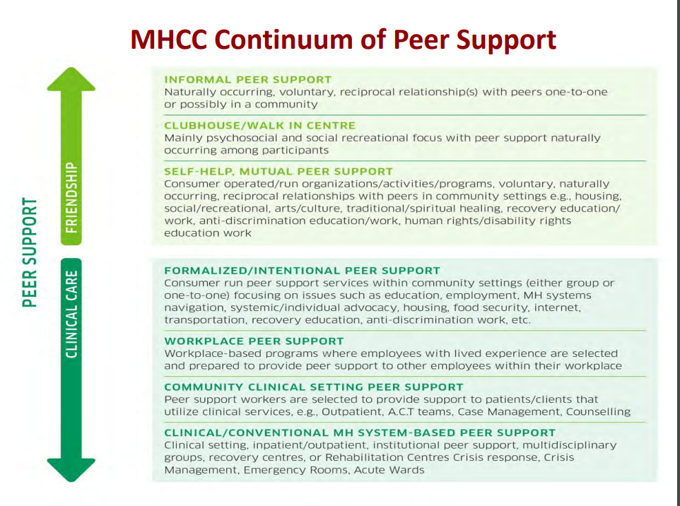
Notes:
TRAINER
“Mental Health Commission of Canada recognizes that there is a continuum of Peer Support, which means that there are more informal styles of Peer Support—such as naturally-formed relationships between members of the same community—as well as more formalized versions of Peer Support—such as Peer Support groups run out of hospitals and rehabilitation centres. This Peer Support training is geared towards the more formalized settings, but the skills and knowledge we will develop will be beneficial for all kinds of relationships.”
Go through the continuum with the participants. Invite people to share what types of Peer Support they have had experience with.

Slide 17
Small Group Activity
Module 1 – Introduction to Peer Support
Discuss the benefits of peer support, and if you are comfortable, share your experiences with peer support and how it impacted you.
How did you benefit from receiving Peer Support?
How did you benefit from offering Peer Support?
(This activity should take approximately 10 to 15 minutes.)
Notes:
COORDINATOR
Read the instructions for the second breakout room activity. Give 10-15 minutes for the activity.

Slide 18
Benefits in Receiving Peer Support
Module 1 – Introduction to Peer Support
“Acceptance, someone to talk to, someone who challenges your thought patterns, someone who shows by example that there is life after being diagnosed with a mental illness (HOPE).”
“Empowerment, hope, and a sense that others have faced the same tribulations and overcome, through a sense of common ground and understanding.”
“I have often heard from others that receiving peer support is very beneficial to them. Having someone accept you for you and believing in you and offering hope has change.”
From PeerWorks Toolkit Project Initial Membership Survey
Notes:
TRAINER
Ask people to share the benefits in receiving Peer Support. If the group is talkative, you might not need to share this slide. If the group is quieter, start the conversation off with some of these benefits quoted from Peer Supporters.

Slide 19
Benefits in Offering Peer Support
Module 1 – Introduction to Peer Support
“As no two issues are ever the same, the person providing the Peer Support is always learning and growing. You certainly get to know the Mental Health System in your area, what is and what is not available. You also have the satisfaction of seeing someone who seemed to be stuck move forward and attain success.”
“Feeling useful…of giving back, learning about themselves. It’s a paradox, while helping others we can discover more about ourselves.”
“Feels that their lived experience is of value in helping others. Their personal struggle becomes a valued qualification.”
From PeerWorks Toolkit Project Initial Membership Survey
Notes:
TRAINER
Ask people to share the benefits in offering Peer Support. If the group is talkative, you might not need to share this slide. If the group is quieter, start the conversation off with some of these benefits quoted from Peer Supporters.
“You’ve reached the end of our first synchronous session, only 16 more to go. Now that you have experienced one module, what questions do you have moving forward?”
“Throughout the modules, there will be group activities, discussions, quizzes, and written responses. Some of these written responses will be during our sessions, while others will be done on your own time. We will always let you know which homework pieces will need to be submitted. This variety of work represents the evaluation of the training program.
The trainers will be taking notes on your progress throughout the synchronous sessions and offering feedback where required. There will be an opportunity during each synchronous session to reflect on the homework, share ideas and ask questions.”

Slide 20
Resources
Module 1 – Introduction to Peer Support
Sign up for PeerWorks’ NewsToGo newsletter: https://opdi.us8.list-manage.com/subscribe?u=8f832ee75cf3305556ea0f0ce&id=cb2e85f8fc
Steps on How to Find and Write a Land Acknowledgement in Ontario, Canada
Native Land is an interactive map that helps you learn about the native land we live on. https://native-land.ca/
Indigenous Organizations often offer the most respectful and accurate content:
  Ontario Federation of Indigenous Friendship Centres (OFIFC): https://ofifc.org
  Indigenous Tourism Ontario: https://indigenoustourismontario.ca
  Many institutions provide official land acknowledgements that are deeply researched and are often regionally specific and vetted by Indigenous advisors:
  University of Toronto: https://indigenous.utoronto.ca
  York University: https://indigenous.info.yorku.ca
  University of Waterloo: https://uwaterloo.ca/indigenous
  OCAD University, Ryerson (TMU), McMaster, and others also have detailed acknowledgements
Local municipalities in Ontario often publish official acknowledgements on their websites:
  City of Toronto: https://www.toronto.ca
  Ottawa, Hamilton, Mississauga, London, Sudbury, etc. all have their own
Notes:
COORDINATOR
Read the resources.

Slide 21
Homework (Part 1 of 2)
Module 1 – Introduction to Peer Support
For Next Time:
At the beginning of this session, we discussed our Expectations. We will have a refresher of these Expectations at the beginning of every synchronous session.
In preparation for our next session, re-read the Expectations and consider if you think anything is missing.
We want this to be a nonjudgmental and comfortable space for ALL OF US, meaning our Expectations should reflect those of everyone in this Zoom community.
Notes:
COORDINATOR
Read through the homework for next time.

Slide 22
Homework (Part 2 of 2)
Module 1 – Introduction to Peer Support
For Next Time:
Please submit your revised “Peer Support” definition by the next session.
The homework for the next session includes two recovery stories written by PeerWorks collaborators Christian and Tanya.
The third reading is an excerpt from Mark Ragins’ paper “Person-Centered vs. Illness-Centered.”
Please take note of any questions you have regarding the reading. There will be time at the beginning of the next session to discuss the main points of the reading and address any questions, clarifications, or ideas inspired by the homework.
The homework should take between 25 – 40 minutes.
Notes:
COORDINATOR
Read through the homework for next time.

Slide 23
Facilitator and the Training Coordinator will be available at the end of every session for 10 minutes for homework related questions or for clarification on today’s sessions.
If you need additional support here are some resources:
988 Crisis line
Warmlines to speak with a peer with lived experience call:
Progress Place
416-960-9276
Text 647-557-5882
Krasman Centre
1-888-777-0979 24-7
Northern Initiative for Social Action (NISA) Warmline serving Northwest Ontario
1-866-856-9276(WARM)
Module 1- Introduction to Peer Support

Slide 24
Thank You
Notes:
TRAINER
“Thank you all for attending this first session and sharing with us. We look forward to getting to know you over the next few weeks and seeing you progress as Peer Supporters.”

